Slide 1
Units of Energy – Practical Applications
Miss Lum
Year 11 Essentials

Slide 2

Learning Outcomes
Dot Points
1.2.1 Identify common use of formulas to describe practical relationships between quantities
1.2.2 Substitute values for the variables in a mathematical formula in given form to calculate the value of the subject of the formula

Slide 3
24
7
30
Units of Energy – Practical Applications
Date: 08/05/2018
EQ – What are some of the practical applications involving units of energy?
How do we link joules to watt hours?
In this unit so far we have examined units of energy related to food and units of energy related to power separately.
It is possible to convert joules to watt hours by knowing that 3600 joules is equivalent to 1 watt hour.
To convert watt hours to joules, multiply by 3600.
To convert joules to watt hours, divide by

Slide 4
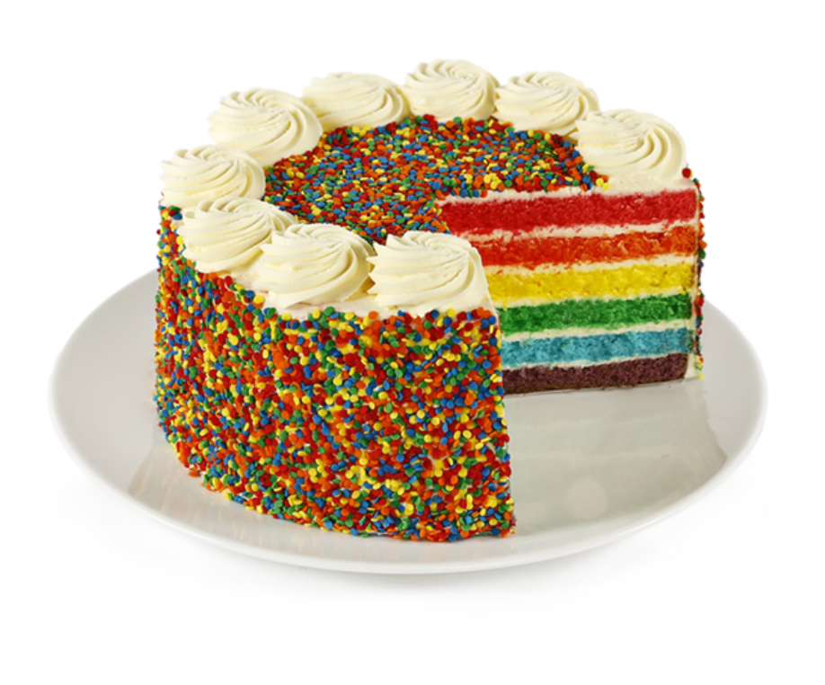
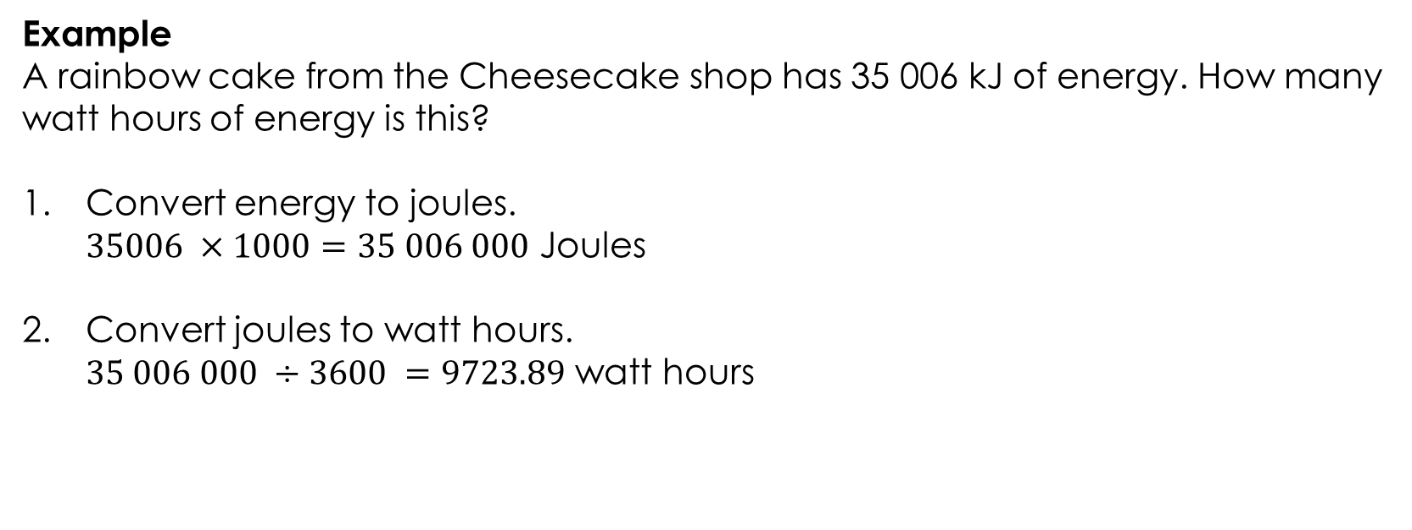
24
7
30
Units of Energy – Practical Applications
Date: 08/05/2018
EQ – What are some of the practical applications involving units of energy?
How do we link joules to watt hours?
Example
A rainbow cake from the Cheesecake shop has 35 006 kJ of energy. How many watt hours of energy is this?
Convert energy to joules. $35006 ×1000=35 006 000$ Joules
Convert joules to watt hours. $35 006 000 ÷3600 =9723.89$ watt hours

Slide 5
Task
Complete MAWA Essentials 11 Chapter 10 Questions 1 -5 pp 42-45

Slide 6
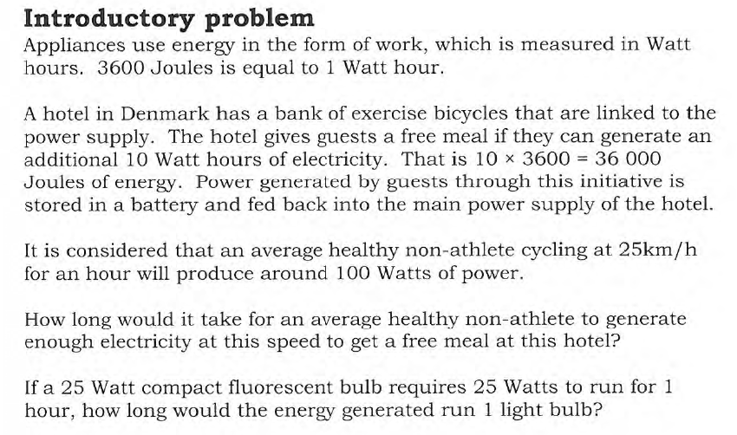
Task

Slide 7
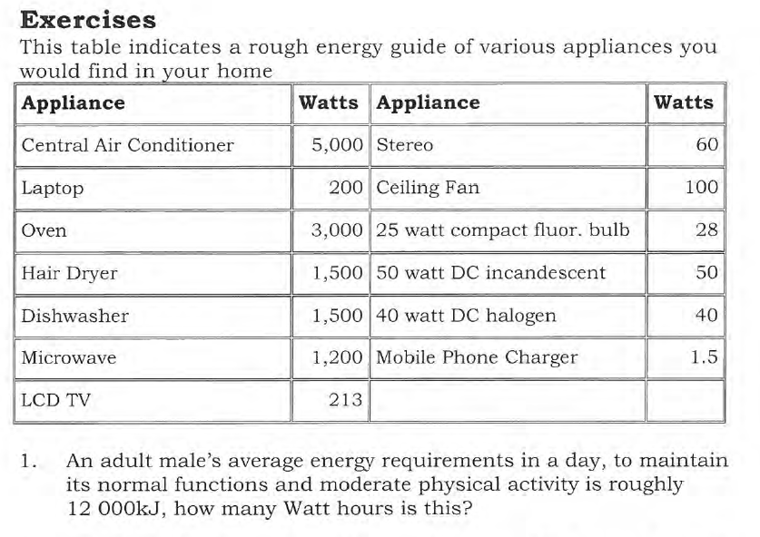
Task

Slide 8
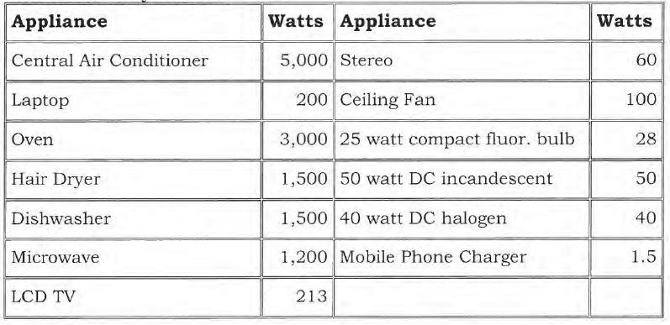
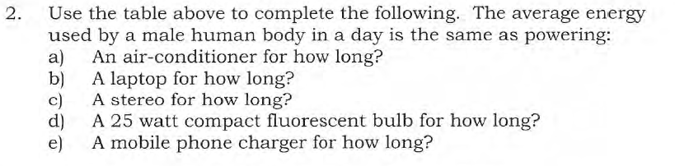
Task

Slide 9
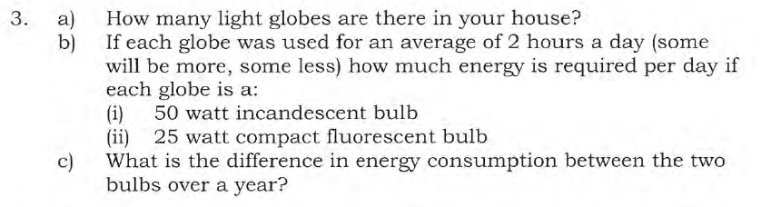
Task

Slide 10
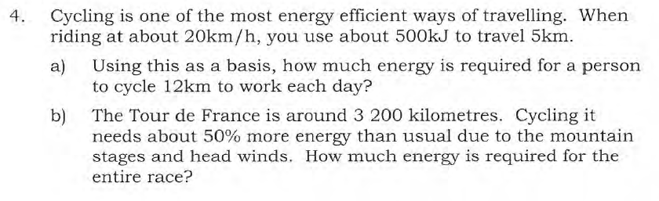
Task

Slide 11
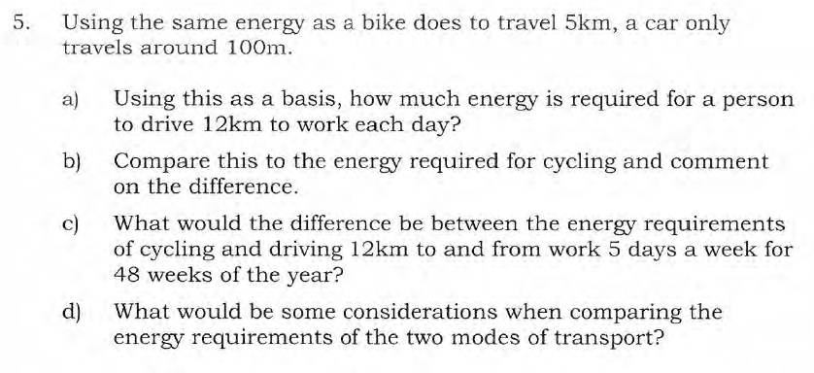
Task

